Slide 1
Texas Tech University Health Sciences Center
Purchasing quarterly meeting
Ttuhsc pURCHASING

Slide 2
Agenda
General TechBuy information:
  Marking Orders as Urgent Priority
  Accounting date
  Buyer contact information
  Internal/External Notes
  Attachments:
    Label attachments (ICQ, COI, Quote)
    Attach documents separately (ICQ, COI, Quote)
    Internal vs. External attachments
  Purchase Category Selection on Non-Catalog Forms
  User Profiles
    Phone number and department
    Bill To
Bid Limits
Contract Submission
Ethics/Conflict of Interest
Legislation Session Information
El Paso
Purchasing Email
  Sciquest.com emails
  Correct email: purchasing@ttuhsc.edu
Accounts Payable:
  Direct Pay
  Receiving
Upcoming On Campus Training
Questions and Answer Period

Slide 3
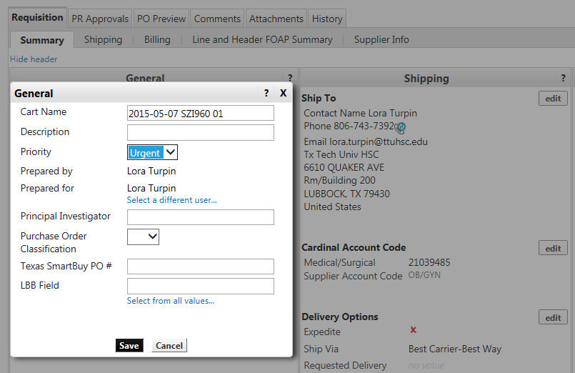
General TechBuy Information
Marking orders as Urgent Priority
Orders that are Urgent need to be marked as Urgent in the priority field. Only orders that are true Urgent orders should be marked and if we find they are not Urgent we will remove the priority. For example, an Urgent order would be an order where the services will be occurring the next day or soon after that will require quicker processing.
In your cart, click edit under the general section, then select Urgent from the drop down menu under Priority.

Slide 4
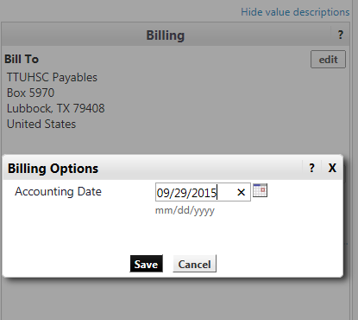
Accounting Date
The accounting date field should always be populated by the current date. Banner is a date
driven program and it reads the accounting date from TechBuy. For example, if a vendor or
budget is set up after the accounting date the TechBuy order will fail because Banner is reading
the earlier date in the accounting field.
In your cart, click edit under the billing section and change the accounting date.

Slide 5
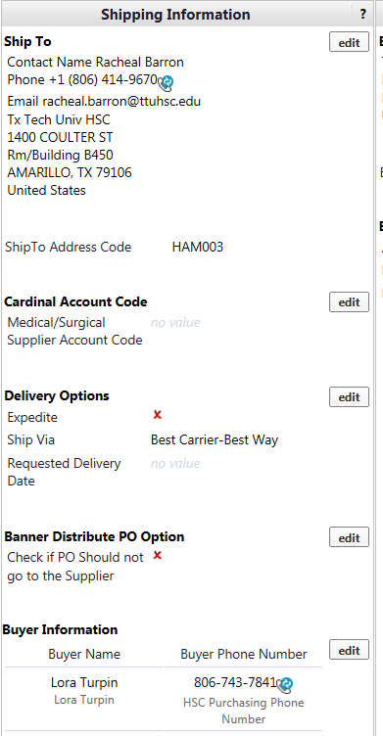
Buyer Contact Information
The Buyer Contact information is located under the Shipping Information section at the bottom of the section. If you have a question about your PO please reference this section to locate the Buyer name and phone number for help with your order. We will begin to forward all calls and emails to the appropriate buyer.

Slide 6
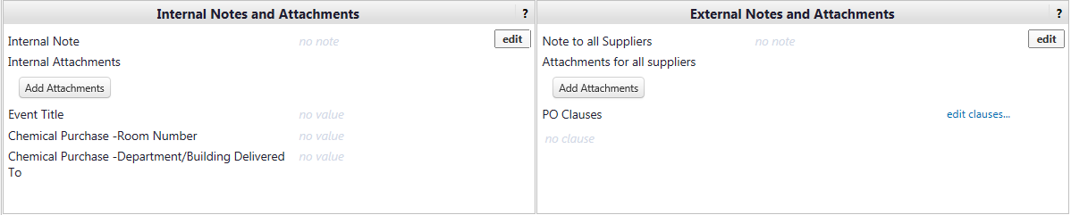
Internal/External Notes
Internal Notes:
Please use the internal notes to communicate information to the Buyers. The internal notes will not be sent to the vendor.
External Notes:
Please use the external notes to communicate information to the Vendors. The external notes are sent to the vendor.
In your cart, click edit under Internal or External notes and type note into field.

Slide 7
Attachments
Label all attachments as the type of document it is. (ICQ, COI, Quote)
Attach documents separately. Do not scan all documents into one document as this causes issues when one document needs to be removed.
Internal vs. External Attachments:
  Internal attachments are attachments that DO NOT need to go out to the vendor.
    Internal attachments examples:
      ICQ
      COI
      W-9/W-8
      Internal emails
  External attachments are attachments that DO need to go out to the vendor. The external attachments should also be pdf files. Other files cause the order to fail.
    External attachments examples:
      Quotes
      Approved artwork

Slide 8
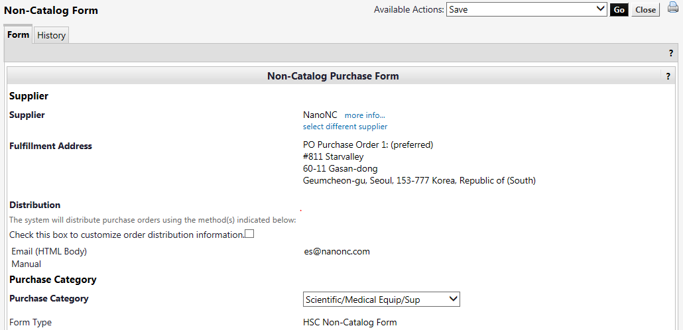
Purchase Category Selection on Non-Catalog Forms
The Purchase Category field is used to route orders to the appropriate buyer. When selecting a category please select the category that fits the majority of the order. Please do not select multiple categories for one purchase order as this will route the order to several different areas and could delay the processing of your order.
In the Non-Catalog form, select the appropriate Purchase Category from the drop down menu.

Slide 9
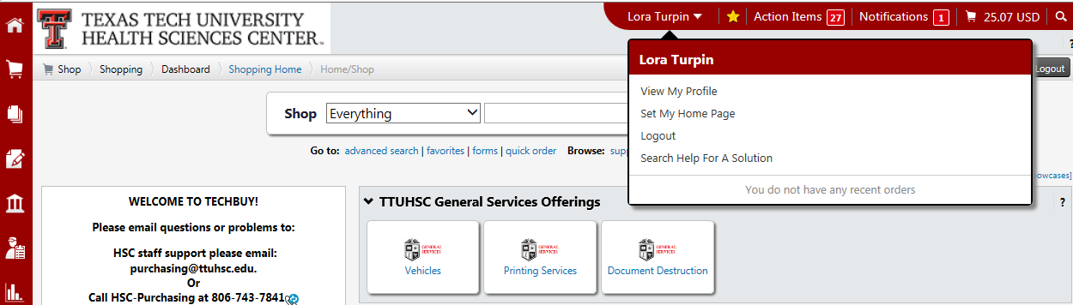
User Profiles
Phone number and department
There have been several phone number and departmental changes campus wide. Please verify your contact information is correct. (phone number and department)
To view your profile select your name in the top panel. Click view my profile.

Slide 10
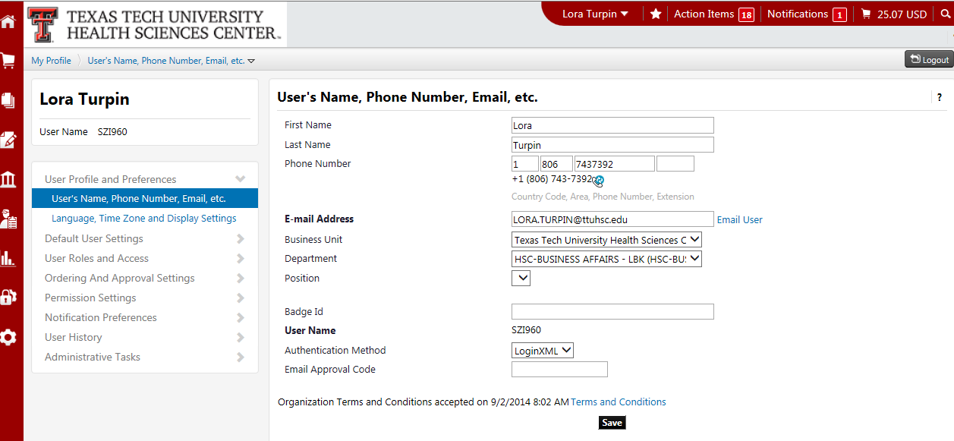
Verify all contact information is correct (phone number and department).

Slide 11
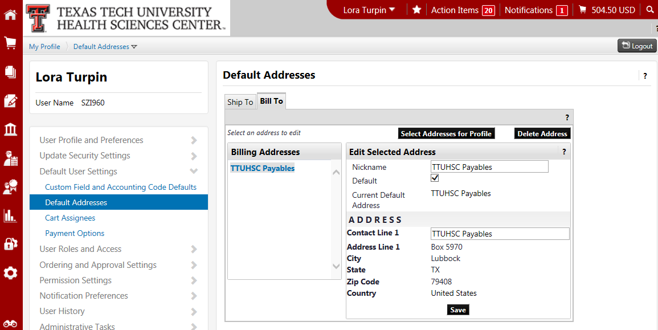
Bill To
Verify the Bill To in your profile is set to TTUHSC Payables.
Click on default addresses and bill to to verify you have the correct bill to set up.

Slide 12
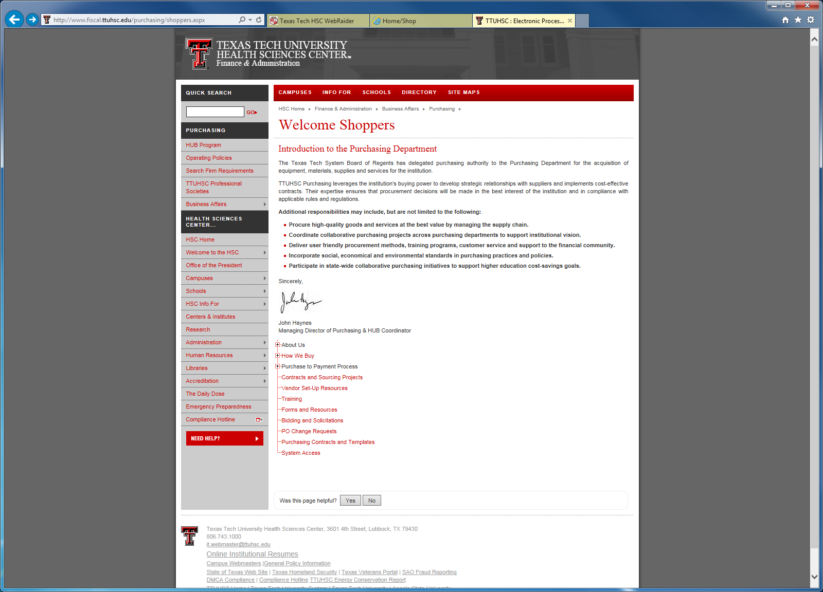
Bid Limits
The Purchasing Department has the responsibility to assist departments to make the best value acquisition of quality materials and services in accordance with Texas Procurement laws.
The Bidding and Solicitation page can be accessed by clicking on Bidding and Solicitations.

Slide 13
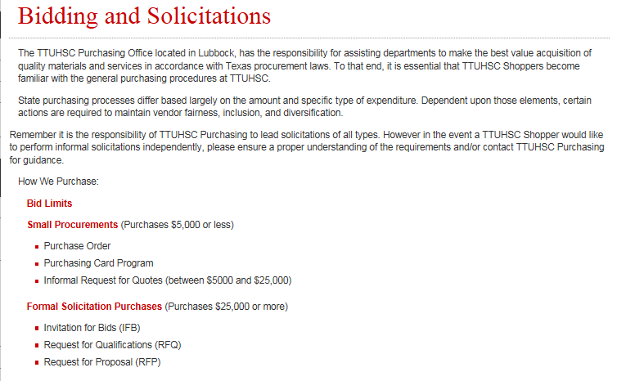
Next, Click on Bid Limits.

Slide 14
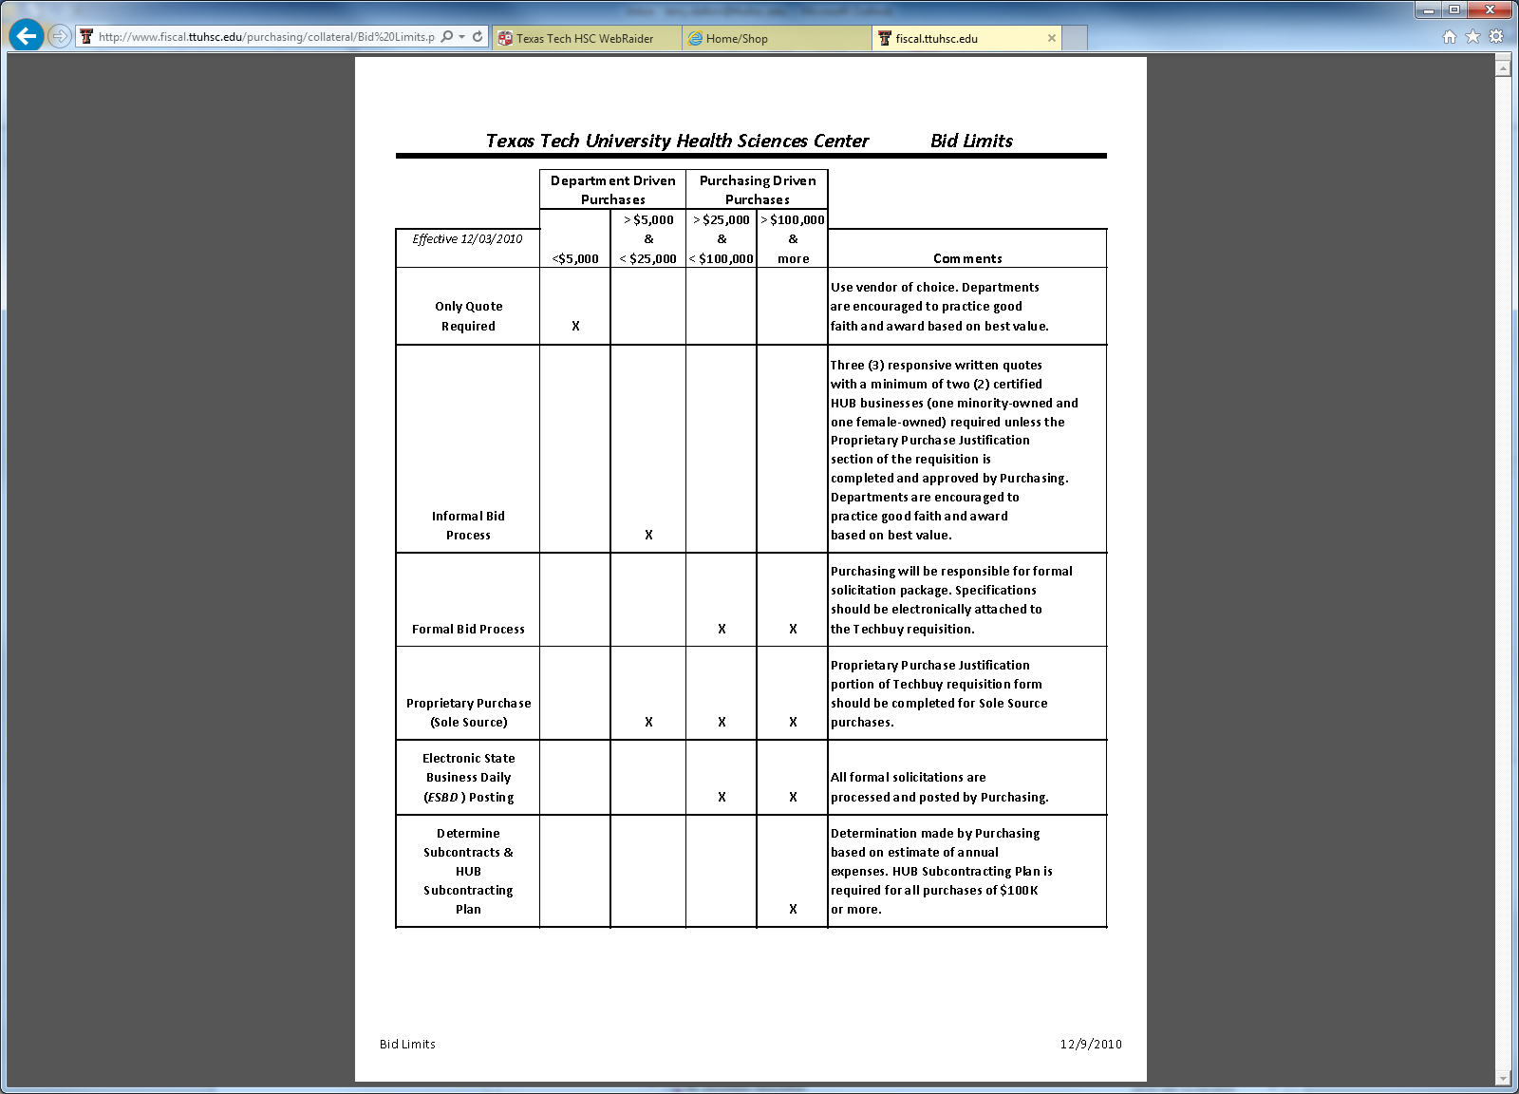
State purchasing processes differ based largely on the amount and specific type of expenditure.

Slide 15
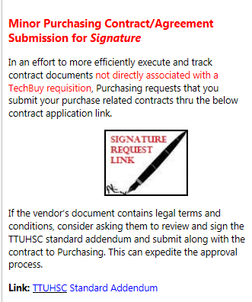
Contract Submission
Contracting has launched its new contracting system. Please make sure to submit your signature requests through the new contracting system.
From your shopping home page, in the announcements section, click on the signature request link. This will take you to the new contracting submission page.
Or use link:
https://eraider.ttuhsc.edu/signin.asp?redirect=https://www.fiscal.ttuhsc.edu/sso/index.aspx&

Slide 16
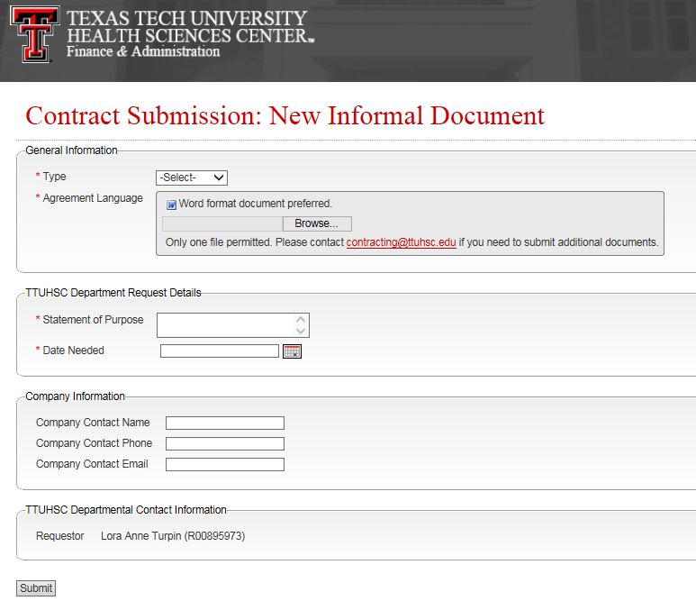
Complete form with appropriate information. All fields with a * are required fields. Once complete select submit.

Slide 17
Ethics/Conflict of Interest
Please review and become familiar with Ethics/Conflict of Interest documents that are available on the websites below.
OP 10.05
http://www.ttuhsc.edu/hsc/op/op10/op1005.pdf
Texas Government Code Chapter 572
http://www.statutes.legis.state.tx.us/docs/gv/htm/gv.572.htm
Regents’ Rule 03.01 – 03.02
http://www.depts.ttu.edu/oppol/Chapter03.pdf

Slide 18
Legislation Session Information
There have been several legislative changes in the recent months that will be implemented in the near future.
A few highlights:
  Transparency
  DIR Orders over $25,000
  $1 million Board of Regents Approval
    $1 million for the full term of the agreement (not per FY)
    Additional processing time
These are highlights of possible changes and there will be more clarification
after the October Board of Regents meeting.

Slide 19
El Paso
As of 9/1/2015 (FY16) the El Paso Campus is its own State entity. If you process orders on El Paso
Funds it will route to El Paso Purchasing. Please see list of contacts below.
El Paso Purchasing Contacts
Purchasingelp@ttuhsc.edu
Annette A. Hinojos
Annette.A.Hinojos@ttuhsc.edu
915-215-4582
Juan Frias
Juan.Frias@ttuhsc.edu
915-215-4554
Efisio Setzu
Gerardo.Efisio.Setzu@ttuhsc.edu
915-215-4927
Mary Vasquez
Mary.C.Vasquez@ttuhsc.edu
915-215-5070

Slide 20
Purchasing Email
System Generated emails – DO NOT hit reply to system generated emails (emails that come from SciQuest). Sciquest emails are monitored by TTU staff and only one HSC staff member. Please create a new email or forward email to Purchasing@ttuhsc.edu
Please make sure to use the correct Purchasing inbox email address: Purchasing@ttuhsc.edu

Slide 21
Accounts Payable
Direct Pay
Definition of Direct Pay Expenditures
Direct pay expenditures are those for which the department is initiating payment for products and/or services that have already been received, have occurred, or customarily require advance payment, and are specifically identified below. The expenditures do not fall under other statutory purchasing requirements as determined by Purchasing.
Do not use a form for an expenditure that must be processed in TechBuy as a PO. Non-compliant invoices that are not Direct Pay Expenditures as outlined in OP 72.03 cannot be processed on this form – it will be rejected.

Slide 22
Accounts Payable
Direct Pay Expenditures – Specified on the Form
Select the Form for the Direct Pay Expenditure
Hover over the box for additional information, i.e., employee reimbursement allowed or not
Information available on the left side of the form
Account code identified on a specific form must be used
Link to TTUHSC OP 72.03 Direct Pay Expenditures and the required additional forms for a particular expenditure
On the Employee Reimbursement Form – one must choose an account that is relevant to the reimbursement

Slide 23
Accounts Payable
Employee Reimbursements OP 72.03 (page 8)
All employee reimbursements must be processed in TechBuy using the direct pay form – TTUHSC Employee Reimbursements. Required supporting documents must be attached as detailed above for the allowable expenditures. Additional required documentation is proof of payment by the employee such as a cancelled check, bank or credit card statement. Signature of the employee’s supervisor or a superior of the employee is required if the fund manager approving the reimbursement is not their immediate supervisor. An approval email from the supervisor or the Approval Form for Employee Reimbursement must be attached to the direct pay form.
Expenditures for supplies and equipment for institutional use should be made in accordance with guidelines established through the Purchasing department as stated in HSC OPs 72.01 through 72.15. Employee reimbursements are allowed only as specified within these HSC OPs. Employees purchasing supplies or equipment with personal funds and subsequently requesting reimbursement from institutional funds are operating outside the guidelines set forth in these HSC Purchasing OPs. Reimbursement for such expenditures could be denied.
The preferred method of payment for memberships and registration fees is the purchasing card.

Slide 24
Accounts Payable
Reminders
Fund Manager will receive an email to approve. A Requisition will be created with an identifying #. The requisition will route to Accounts Payable. When AP approves the requisition, simultaneously a PO and an e-Invoice is created and the payment processes as a “V9xxxxxx”.
Do not mail or send to the Accounts Payable email address the invoice and supporting documents. It is already attached to the requisition of the Direct Pay Form. When you see the PO number – that means that the Requisition has been processed for payment.
If any of the supporting documentation is missing, the requisition will be rejected. Adding a comment and waiting for a response is delaying the processing of requisitions that are not completed in their entirety.
All questions or assistance should be directed to Accounts Payable and not the Purchasing Department. Contact information is as follows:
Accounts.Payable@ttuhsc.edu
Payment Services 806-743-7826

Slide 25
Accounts Payable
Receiving
Department Responsibility for Receiving Information
Inspect and/or accept goods purchased or services performed. Inspection is the critical examination of goods and services delivered to determine that the items or services received meet the standards and quantities specified in the order or contract.
All receiving information must be submitted in TechBuy within 3 days after the goods are received or the services completed.
Although departments are not receiving paper invoices or requests from Accounts Payable to complete receiving documentation for eInvoices, receiving must still be completed in TechBuy.
Invoices that are sent directly from a vendor to a department must still have receiving completed in TechBuy. Documenting that an invoice is “okay to pay” with a departmental signature is not enough.
The receiving date of the item or completion of services may have a different date then when approving the invoice to pay. Enter in the “receipt date” field the “ACTUAL DATE” the goods/services are received.

Slide 26
Accounts Payable
A Receiving Tutorial is available at http://www.fiscal.ttuhsc.edu/busserv/ap/. If you need additional help with processing the receiving information, please email AccountsPayable@ttuhsc.edu. Someone will contact you and walk through the process with you.
IMPORTANT REMINDERS:
Many times the date of creating a receipt is different than the date that you actually received the item(s) or the service(s). Please remember to make that distinction when you enter “receiving data” in TechBuy. If the PO has many line items, be sure to select “remove line” for the items that have not yet been received. Do not leave the “quantity” field at zero. REMOVE THE LINE.
Those who process standing order POs need to enter receiving as a cost receipt and not a quantity receipt even if we are being billed for items.

Slide 27
Pcard / Foreign Vendors
Pcard has limited pre-approval categories for purchases from a Foreign Vendor.
All Foreign Vendor Pcard requests must have pre-approval from Purchasing before the Pcard can be used.
The majority of foreign purchases must be processed on a purchase order. There are additional approvals required when making a foreign purchase which the Pcard is unable to follow with the current system.

Slide 28
Upcoming On Campus Training
The next training session will be held in November/December at each of the campus locations. Exact dates to be announced.

Slide 29
Questions ?

